Slide 1
How Google Digital Wellbeing improve people life
Huynh Cam Hung
GCS18026

Slide 2
Table of contents
Introduction
Literature review
Data collection
Data analysis
Outcome
Conclusion and Evaluation
Q & A

Slide 3
Introduction
The purpose of the project is to research about Google Digital Wellbeing and its impact.
Objectives of the project:
  Research and analyze smart phone usage of people
  Research the key features of Google Digital Wellbeing
  Research the users opinion of the application
  Analyze the accuracy of the opinions
  Analyze the efficiency of application via opinions

Slide 4
Literature review: Quantitative research
Definition:
It is a systematic research of phenomena observed through numberic data.
Quantitative research methods:
  Survey
  Correlational research
  Casual-Comparative research

Slide 5
Literature review: Quantitative research (cont)
Quantitative research:
Advantages:
  Data collection occur rapidly
  The samples are randomized
  Offer reliable and repeatable data
Disadvantages:
  Can not determine the accuracy of answers
  Unable to follow-up answers
  Participant may not represent the population

Slide 6
Literature review: Qualitative research
Definition:
Quanlitative research is used to gain an in-depth understanding of human behavior and its reasons.
Quantitative research methods:
  Interview
  Focus groups
  Ethnographic research

Slide 7
Literature review: Qualitative research (cont)
Advantages:
  Great detail data
  Open-ended process
  Able to collect predicttive quality data
Disadvantages:
  Time consuming
  Collected data not always accepted
  Repliacting results can be difficult

Slide 8
Data collection
The data collection process was conducted via three methods:
  Survey
  Interview
  Collect data from internet

Slide 9
Data collection: Survey
The survey included 10 selection questions.
These were 20 respondents participating in the survey.
The survey was conducted via Google Form.
Link of the survey form: https://docs.google.com/forms/d/e/1FAIpQLSf8tsP86AqAzo33m2l-IFZX8FyWKclT8I_5XkJpF6epiNVWGg/viewform

Slide 10
Data collection: Interview
The interview included 6 questions.
These were 20 respondents participating in the interview.
The interview was conducted via face to face interview.
Link of the interview questions form: https://docs.google.com/forms/d/e/1FAIpQLSdrLb8AA6yava0K1dJENMNcM_78DEJUp0Qg5DIPb8llBG5Tyg/viewform

Slide 11
Data collection: Collect data from internet
These are two information collected from internet:
  Features of Google Digital Wellbeing:
    Five main features of the application: Dashboard, Focus Mode, App Timer, Wind Down.
    Link:https://wellbeing.google/tools/
  The feedbacks from users.
    12 most detailed and valuable feedbacks from the official review sites.
    Link:https://play.google.com/store/apps/details?id=com.google.android.apps.wellbeing

Slide 12
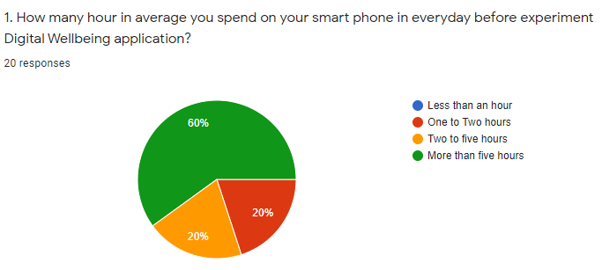
Data analysis: Survey data analysis (cont)
Question 1 data:
  More than five hours: 60%
  Two to five hours: 20%
  Less than two hours: 20%
  Less than an hours: 0%
Analysis result:
  People spend large amount of time on smart phone.

Slide 13
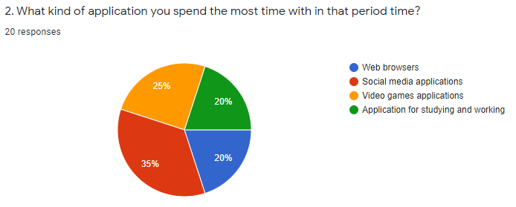
Data analysis: Survey data analysis (cont)
Question 2 data:
  Social media applications: 35%
  Videos games: 25%
  Web browsers: 20%
  Applications for studying and working: 20%
Analysis result:
  People likely to spend time on unhealthy applications.

Slide 14
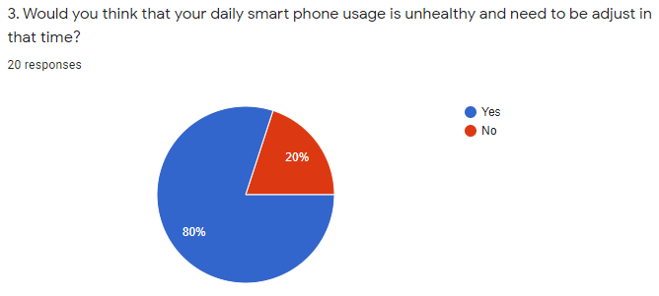
Data analysis: Survey data analysis (cont)
Question 3 data:
  Consider unhealthy: 80%
  Consider healthy: 20%
Analysis result:
  Most of people admitted that their behaviors are unhealthy.

Slide 15
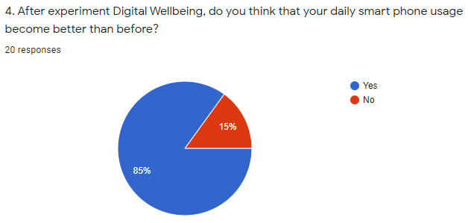
Data analysis: Survey data analysis (cont)
Question 4 data:
  Behavior become better: 85%
  Behavior not become better: 15%
Analysis result:
  Google Digital can help adjusting most of people unhealthy behavior.

Slide 16
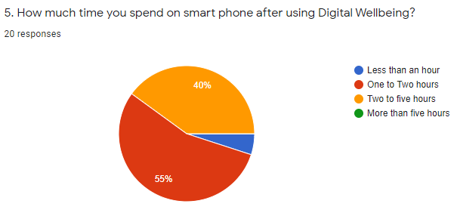
Data analysis: Survey data analysis (cont)
Question 5 data:
  More than five hours: 0%
  Two to five hours: 40%
  Less than two hours: 55%
  Less than an hours: 5%
Analysis result:
  The time of people spend on smart phone reduce significantly after using the application.

Slide 17
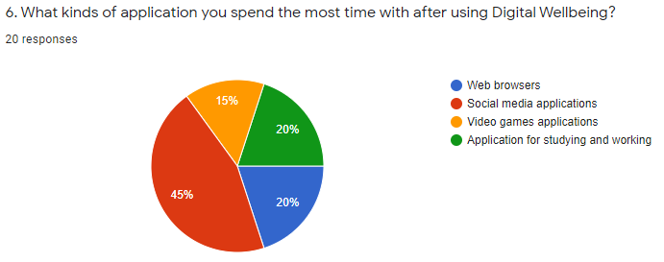
Data analysis: Survey data analysis (cont)
Question 6 data:
  Social media applications: 45%
  Videos games: 15%
  Web browsers: 20%
  Applications for studying and working: 20%
Analysis result:
  The favourite applications of people do not change much.

Slide 18
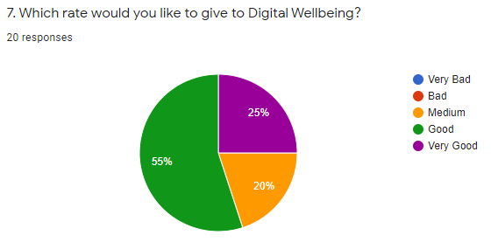
Data analysis: Survey data analysis (cont)
Question 7 data:
  Very good: 25%
  Good: 55%
  Medium: 20%
  Bad: 0%
  Very Bad: 0%
Analysis result:
  Most of people consider Google Digital Wellbeing is a good application.

Slide 19
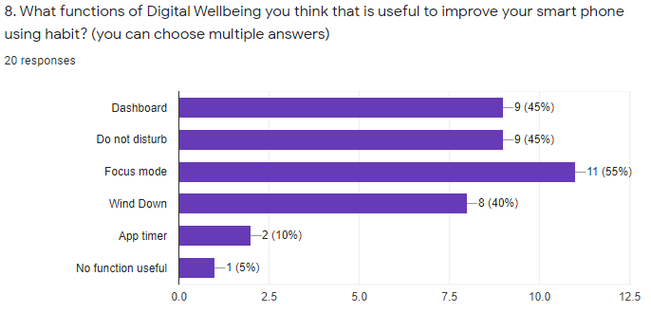
Data analysis: Survey data analysis (cont)
Question 8 data:
  Dashboard: 9(45%)
  Do Not Disturb: 9(45%)
  Focus Mode: 11(55%)
  Wind Down: 8(40%)
  App Timer: 2(10%)
  No function useful: 1(5%)
Analysis result:
  Most of functions, except App Timer, are considered useful.

Slide 20
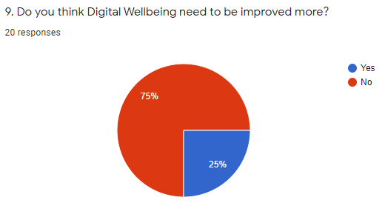
Data analysis: Survey data analysis (cont)
Question 9 data:
  Consider need improvement: 25%
  Consider not need improvement: 75%
Analysis result:
  These are low amount of people do not satisfy with the application.

Slide 21
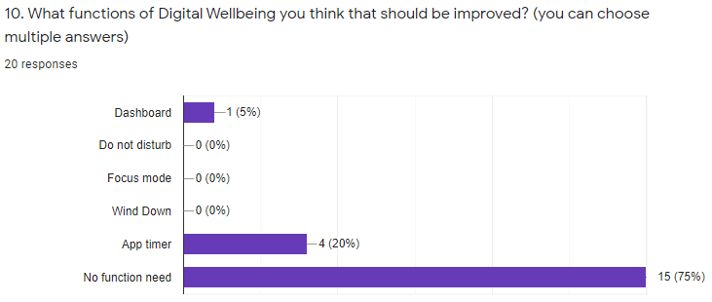
Data analysis: Survey data analysis (cont)
Question 10 data:
  Dashboard: 1(5%)
  Do Not Disturb: 0(0%)
  Focus Mode: 0(0%)
  Wind Down: 0(0%)
  App Timer: 4(20%)
  No function need: 15(75%)
Analysis result:
  Significantly, the dissatisfaction is come from App Timer.

Slide 22
Data analysis: Interview data analysis
Question 1 information:
  12 interviewees spent more than 5 hours on their phone.
  6 interviewees spent two to three hours.
  Only 2 interviewees spend less than an hour.
Analysis result:
  Most of people spend large amount of time on smart phone.

Slide 23
Data analysis: Interview data analysis (cont)
Question 2 information:
  16 interviewees spent most of time on social media and videos game applications.
  4 interviewees spent time on application for their work or study.
  Most of interviewees do not consider their behavior is unhealthy.
Analysis result:
  More than half of people are spending their time on unhealthy applications.

Slide 24
Data analysis: Interview data analysis (cont)
Question 3 information:
  After using Google Digital Wellbeing, most of interviewees behavior is becoming healthier.
  However, 6 interviewees are only slightly better or not better.
Analysis result:
  Google Digital Wellbeing help most of users modify their behavor become healthier.

Slide 25
Data analysis: Interview data analysis (cont)
Question 4 information:
  Most interviewees have positive feed back on the application.
  Their reason is that it includes various kind of features which help them have multiple choice.
  However, it only has smart effect on some of interviewees.
Analysis result:
  Google Digital Wellbeing has great effect on users.

Slide 26
Data analysis: Interview data analysis (cont)
Question 5 information:
  7 interviewees claimed Wind Down is the most useful which stop them using phone at night.
  7 interviewees consider Focus Mode because it help them more focus on their activities,
  4 interviewees choose App timer because it help reducing their addiction on smart phone.
  Unfortunately, 2 interviewees think no function is useful.
Analysis result:
  With the information, the research find out that Wind Down and Focus Mode are mostly considered.

Slide 27
Data analysis: Interview data analysis (cont)
Question 6 information:
  Most interviewees think the application does not need for improvement.
  But some interviewees think that App timer need to be improved.
  App timer is considered that not strict enough to prevent people from addicting. The features can be easily cancelled.
  interviewees think that the feature should be more forceful.
Analysis result:
  Significantly, most of features is good enough for users, howveer, App Timer need for improvement as users mentioned.

Slide 28
Outcome
These are three outcomes of the research project:
  Unhealthy behaviors of people on their smart phone.
  Main features of Google Digital Wellbeing
  Efficiency of Google Digital Wellbeing

Slide 29
Outcome: First outcome
In general, the first outcome has proved that most of smart phone users have unhealthy behaviors.
Users spend more than three hours in average on their phone which considered too much.
Users prefer to use the unhealthy applications (Videos game, social media, ...) instead of healthy one.
The outcome is supported by the data provided from survye and interview.

Slide 30
Outcome: Second outcome
The second outcome includes the information of 4 main features of Google Digital Well being:
  Dashboard
  Focus Mode
  App Timer
  Wind Down
  Do Not Disturb

Slide 31
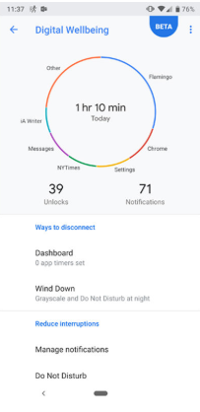
Outcome: Second outcome (cont)
Dash board:
Allow users to see how they spend time on their phone:
  Show the total time spend on phone in the day .
  Show the time on each applications
  Show the daily notifications

Slide 32
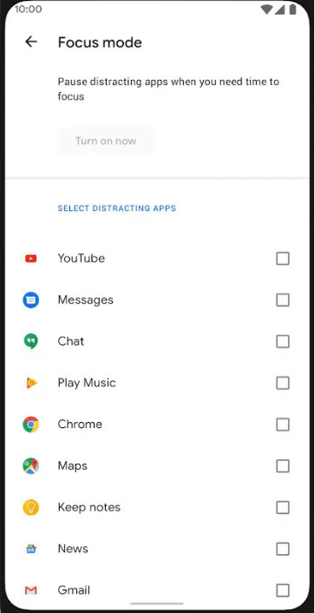
Outcome: Second outcome (cont)
Focus Mode:
Prevent applicatons to distract users:
  Inctivate the selected distracting application.
  Easy to turn on and turn off
  Able to select multiple applications.

Slide 33
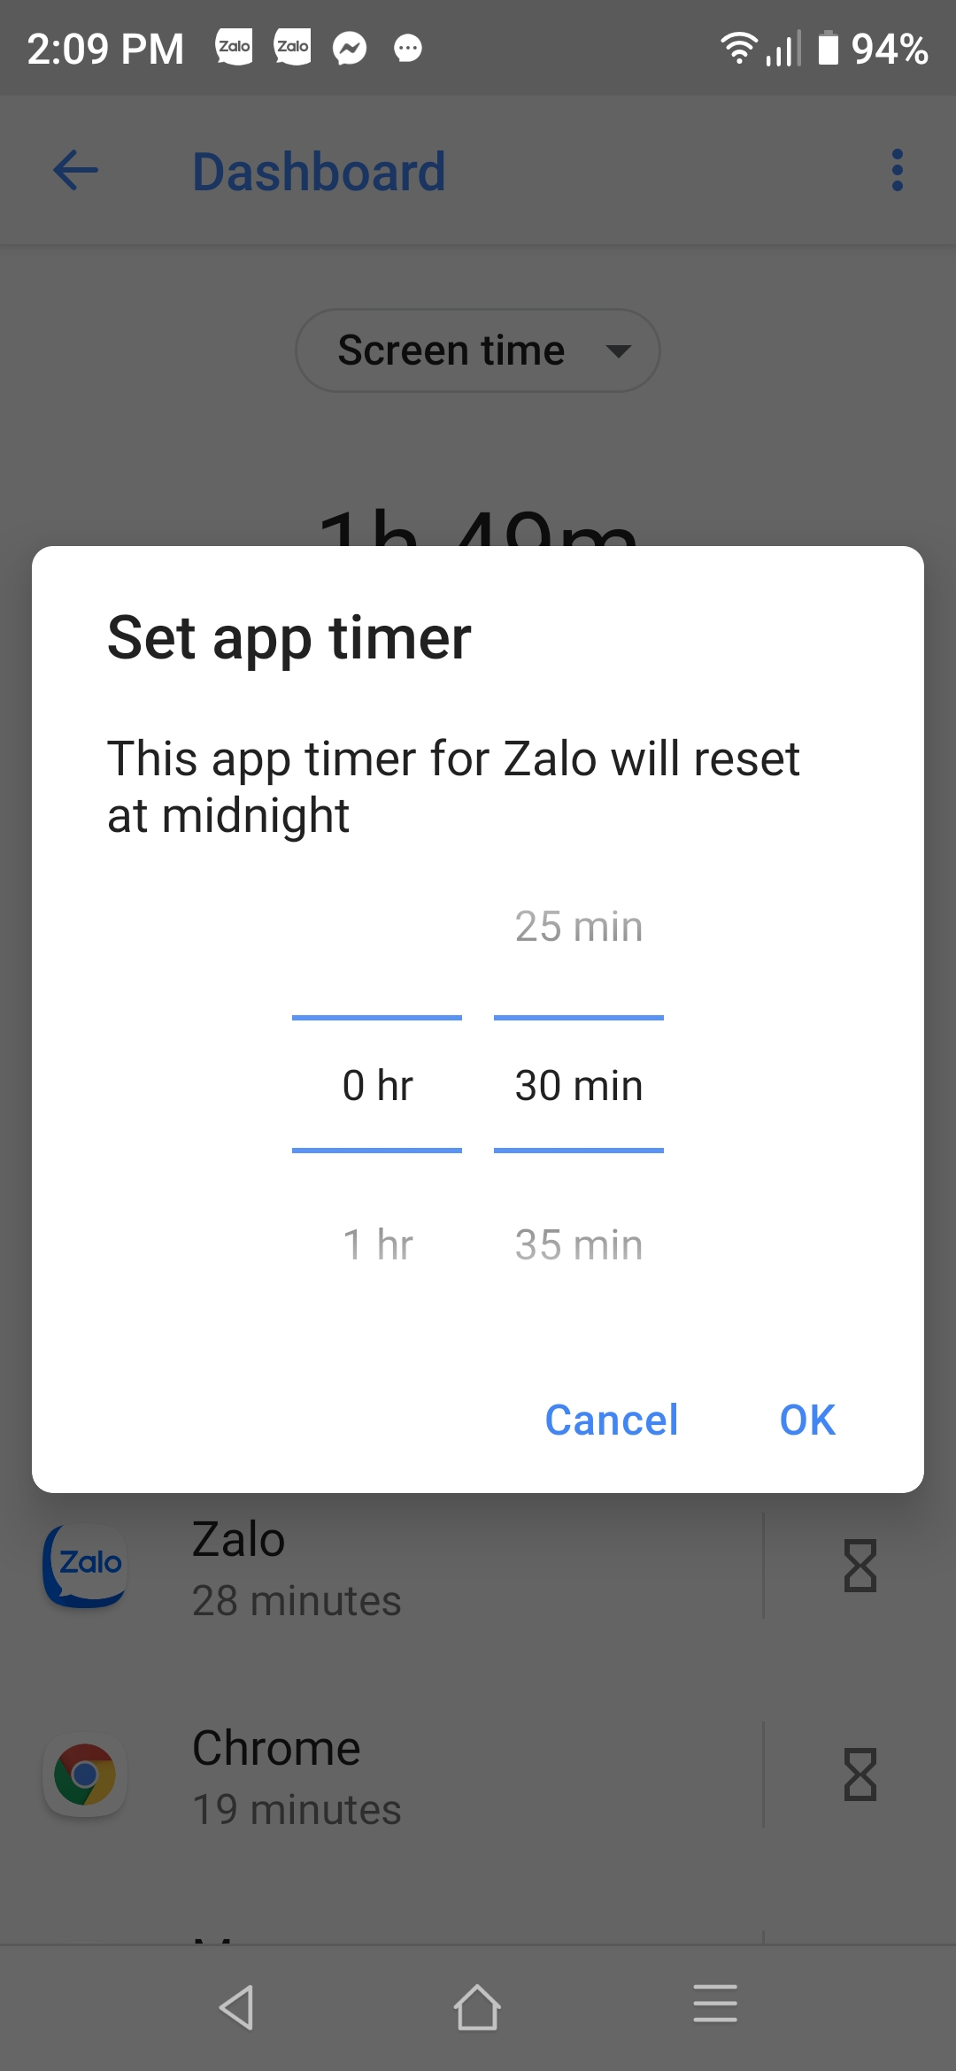
Outcome: Second outcome (cont)
App timer:
Allow users to control applications usage:
  Set the time limit for each application .
  The application will be shut down if the usage reach the limit.
  The feature will prevent users to use the shut down application in the day.

Slide 34
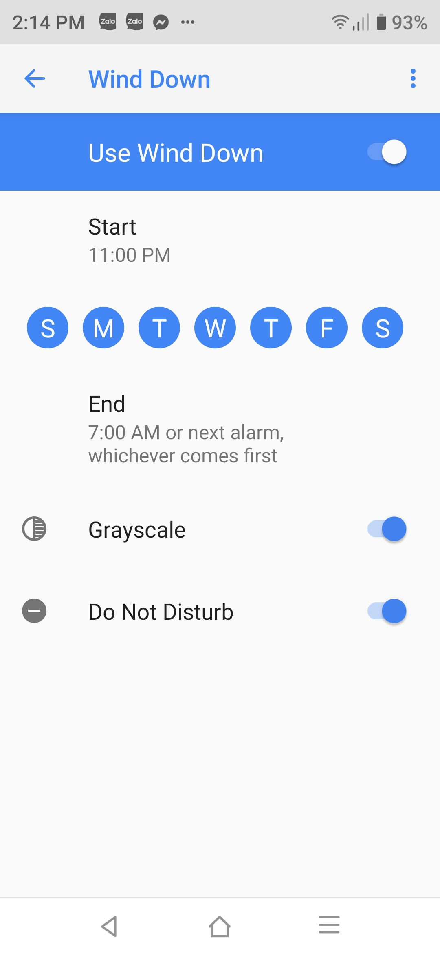
Outcome: Second outcome (cont)
Wind Down:
Wind Down adjust user behavior indirectly:
  Block the notifications for users.
  Turn the interface color to Black and White in the night time.
  The feature will make the smart phone become boring.

Slide 35
Outcome: Third outcome
The third outcome is about the efficiency of Google Digital Wellbeing.
After analyzing the data, Google Digital Wellbeing has been proved that it has good effective impact on people smart phone behavior.
It effectively on reducing the time people spend on the smart phone.
Most of its features have positive feedback from users.
Most of users consider the application is good.

Slide 36
Conclusion and Evaluation
The research project has successfully fulfilled five objectives.
  Understand and find out that people have unhealthy smart phone usage.
  Discover the key features of Google Digital Wellbeing.
  The opinions of users have been collected.
  The accuracy of the opinions has been analyzed.
  With the opinions, the research has concluded the application has good efficiency.

Slide 37
Q & A
1. Are you using Google Digital Wellbeing?
Yes, I am using it because I was having unhealthy usage before.
2. How does Google Digital Wellbeing affect you?
It help me limit the development of unhealthy behavior which can impact my own life seriously.
3. Do you think Google Digital Wellbeing is necessary for society?
Yes, I do. Because it will reduce the time people spend for smart phone and let them spending more time on other healthy and meaningful activities.
4. Do you think Google Digital Wellbeing is needed for improvement?
Yes, I do. Although the research have proved its efficiency, I still found some drawbacks in my experience.

Slide 38
Thank you for listening!

